Slide 1
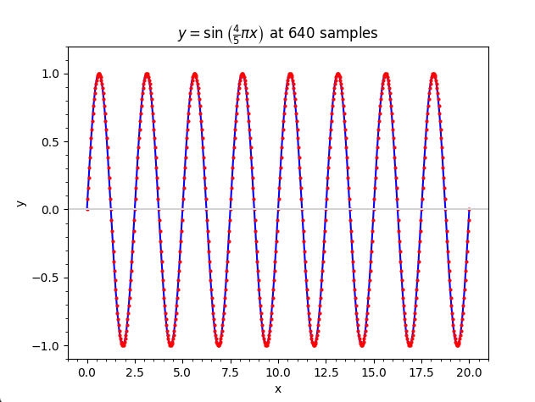
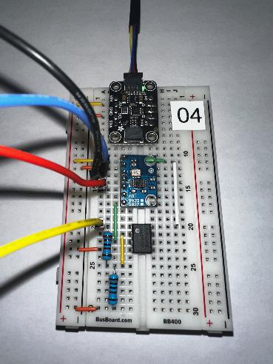
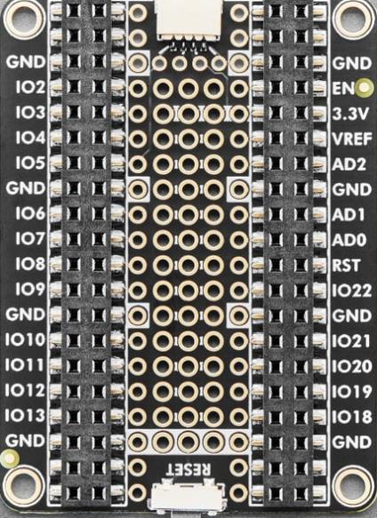
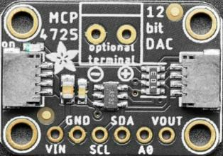
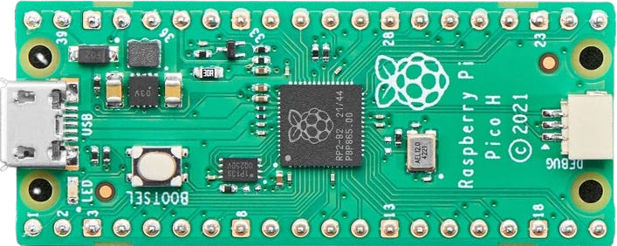
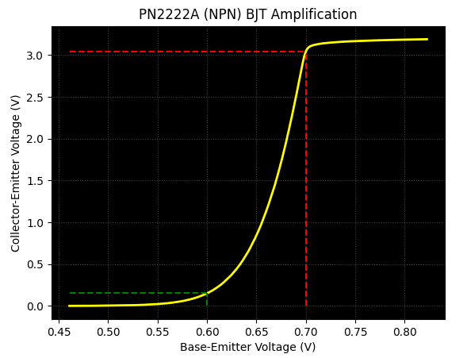

Control System Electronics 101
Using Python and Sensors to Measure Circuits
Board 03
Diode IV Curve,
Photon Energy Band Gap, Ohm's Law
Dave Biersach
dbiersach@bnl.gov

Slide 2
Board 03 – Goals
Learn about diodes, including bias, forward voltage, non-ohmic region, and current limiting resistors
Calculate the band gap for electrons in a Blue LED to determine the voltage necessary for it to emit photons
Differentiate the role of voltage and current in Einstein’s Photon Energy Equation and the brightness of an LED
Apply an NPN BJT in a Common Collector (aka an Emitter Follower) configuration to create a current Buffer that offers high impedance separation between circuit stages
Use Ohm’s Law and Gauss’s Method of Least Squares to identify unknown resistances

Slide 3
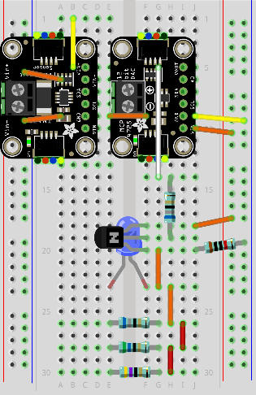
Review Board 03
Board 03 will introduce you to using a current sensor to measure a diode I-V curve, a Blue LED, and using Ohm’s Law to determine the resistance of an unknown resistor
Current
Sensor
DAC
BJT
In a Common Collector configuration
Blue
LED
Three Unknown Resistors

Slide 4
About Diodes
Diodes are semiconductor components that can block a reversed current flow. As such, they are like a one-way valve and are often used to rectify (clip unwanted voltages in) AC (alternating current) signals
Diodes also act as a kind of switch – current cannot flow through a diode until the voltage exceeds a minimum threshold
When the forward voltage exceeds the diode's internal P-N junction barrier voltage (about +0.7V) a charge carrier avalanche occurs
Once sufficiently biased, the diode's forward current increases rapidly for a minimal rise in source voltage, producing a non-linear curve with a distinct "knee" point

Slide 5
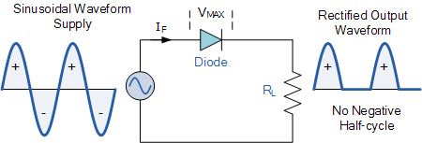
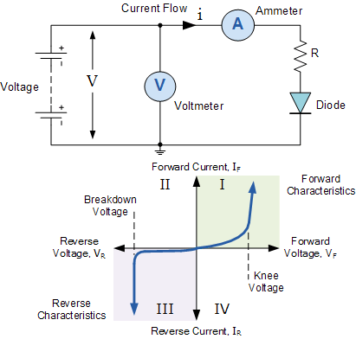
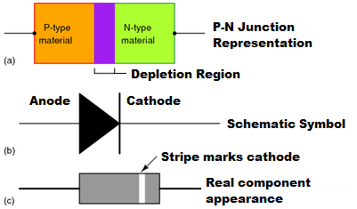
About Diodes
Diode as an AC Rectifier
Diode as a Current Switch

Slide 6
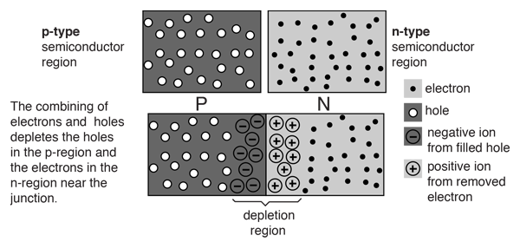
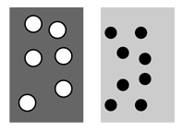
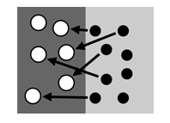
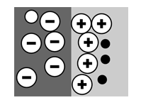
About Diodes
"Holes"
Electrons
Initial Contact
Equilibrium (0V)
No current can flow

Slide 7
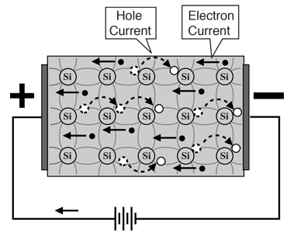
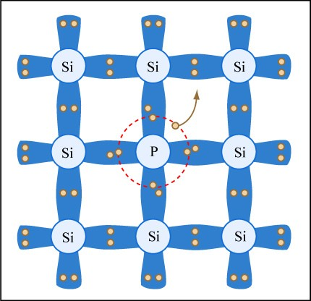
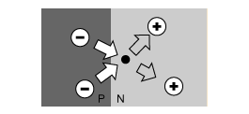
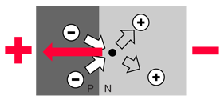
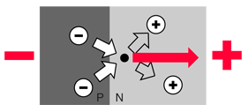
About Diodes
Phosphorus donates electrons
Equilibrium
Forward Biased
Reverse Biased
For current to pass through a diode,
more electrons must flow into the N region

Slide 8
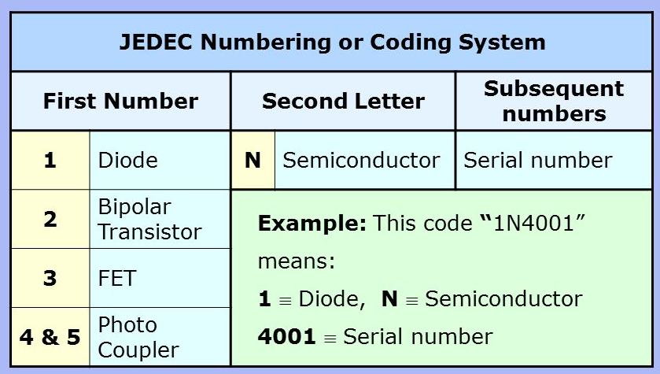
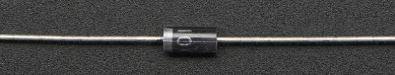
About Diodes
1N4001 Diode

Slide 9
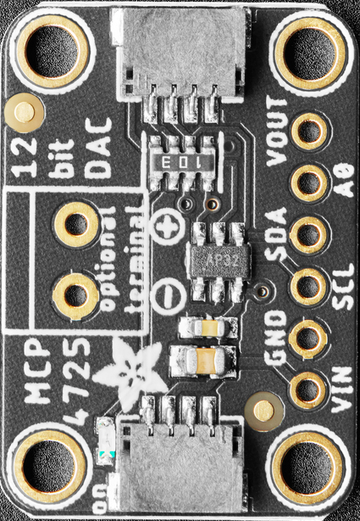

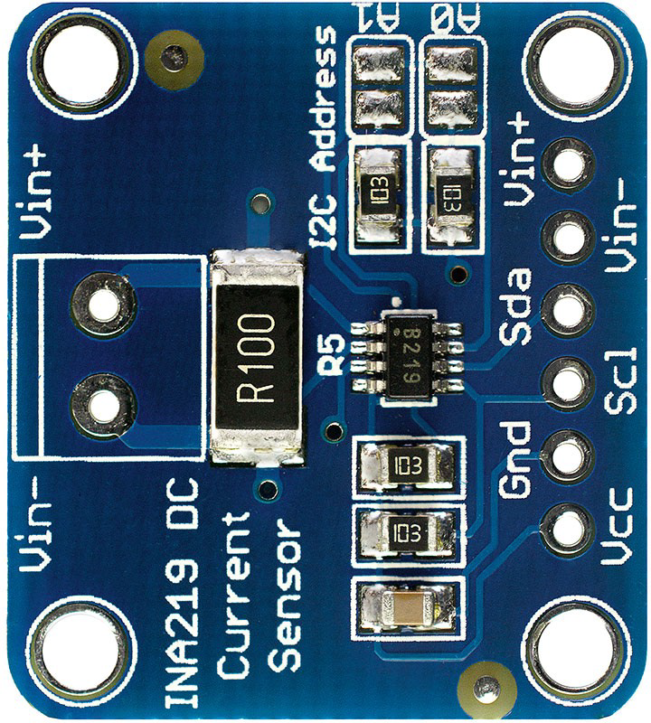
Lab Design
To MCU I²C Bus
All devices on the I2C bus have their respective SDA and SCL pins connected
All Vin and GND pins are connected to the power rails
The Vout pin of MCP4725 DAC ranges voltage (0V to +1.2V) as input to the diode anode
The INA219 Current sensor will measure the current flowing out of the Diode’s cathode
Inside the INA219, the Vin+ pin (connected to the diode) and Vin- pin (connected to GND) are bridged by a 0.1 Ω shunt resistor (R100), thus closing the circuit’s current path
1N4001
Diode
Anode (+)
Cathode (-)

Slide 10
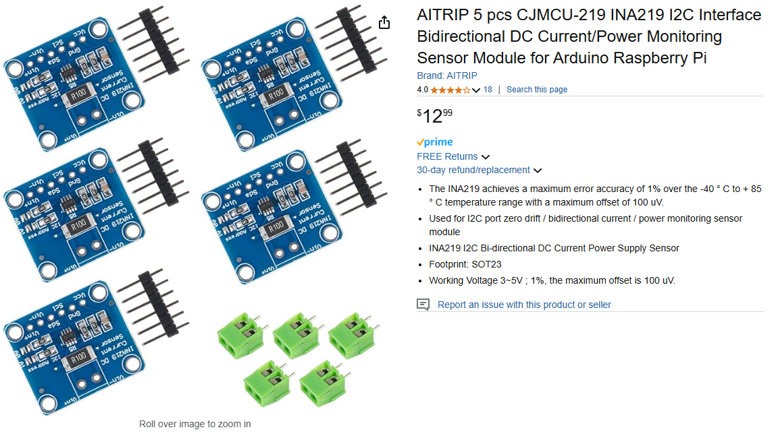
AITRIP INA219 – Current Sensor with I²C
https://www.amazon.com/dp/B08R9MGSWV

Slide 11
Unplug the MCU before changing any wiring!
As we move between each “experiment” on a given breadboard or switch to an entirely new Board #, it is crucial that you FIRST UNPLUG the USB cord!
I recommend unplugging the cord at the PC end – leave the cord connected to the Micro USB port on the Pico
It is dangerous to change any wiring while the MCU is still drawing power from your laptop’s USB port. (NOTE: We will do this only during this Ohm’s Law lab on Board #3!)
If you incorrectly connect a jumper wire between the Pico and the breadboard while the Pico is drawing power from your PC, you can permanently damage your PC’s USB port
Have your partner double-check your wiring every step!

Slide 12
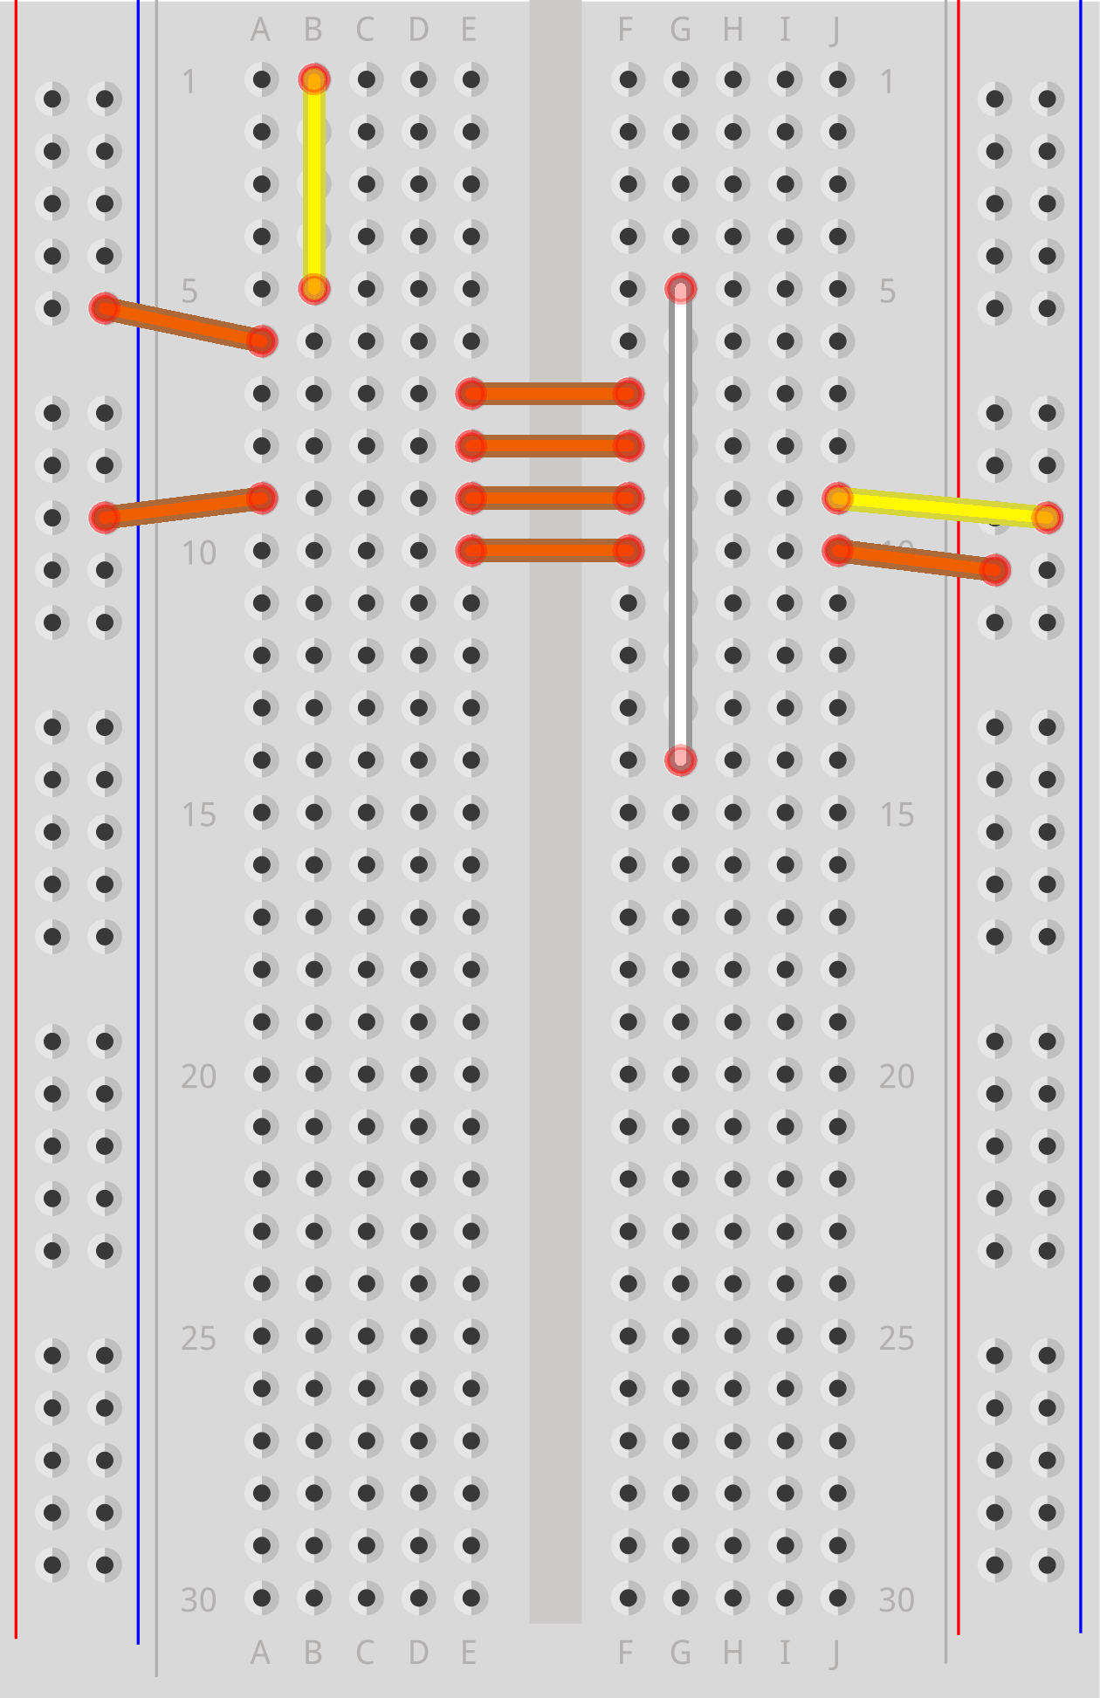
Power Flow (Vcc = +3.3V)

Slide 13
Power Flow (GND)

Slide 14
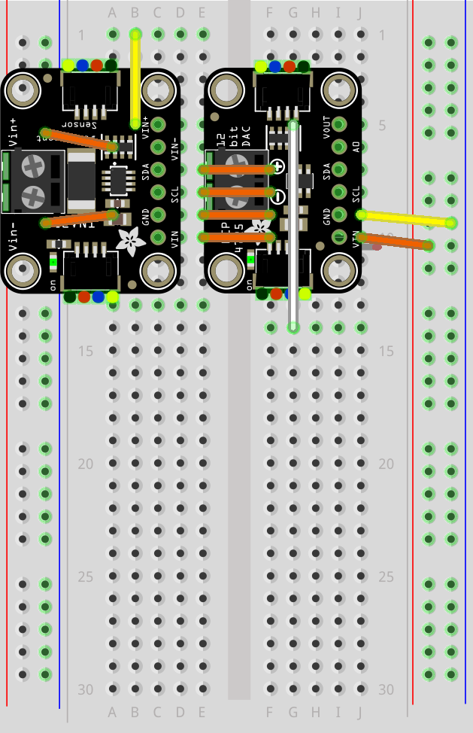
I²C Bus (SCL + SDA)

Slide 15
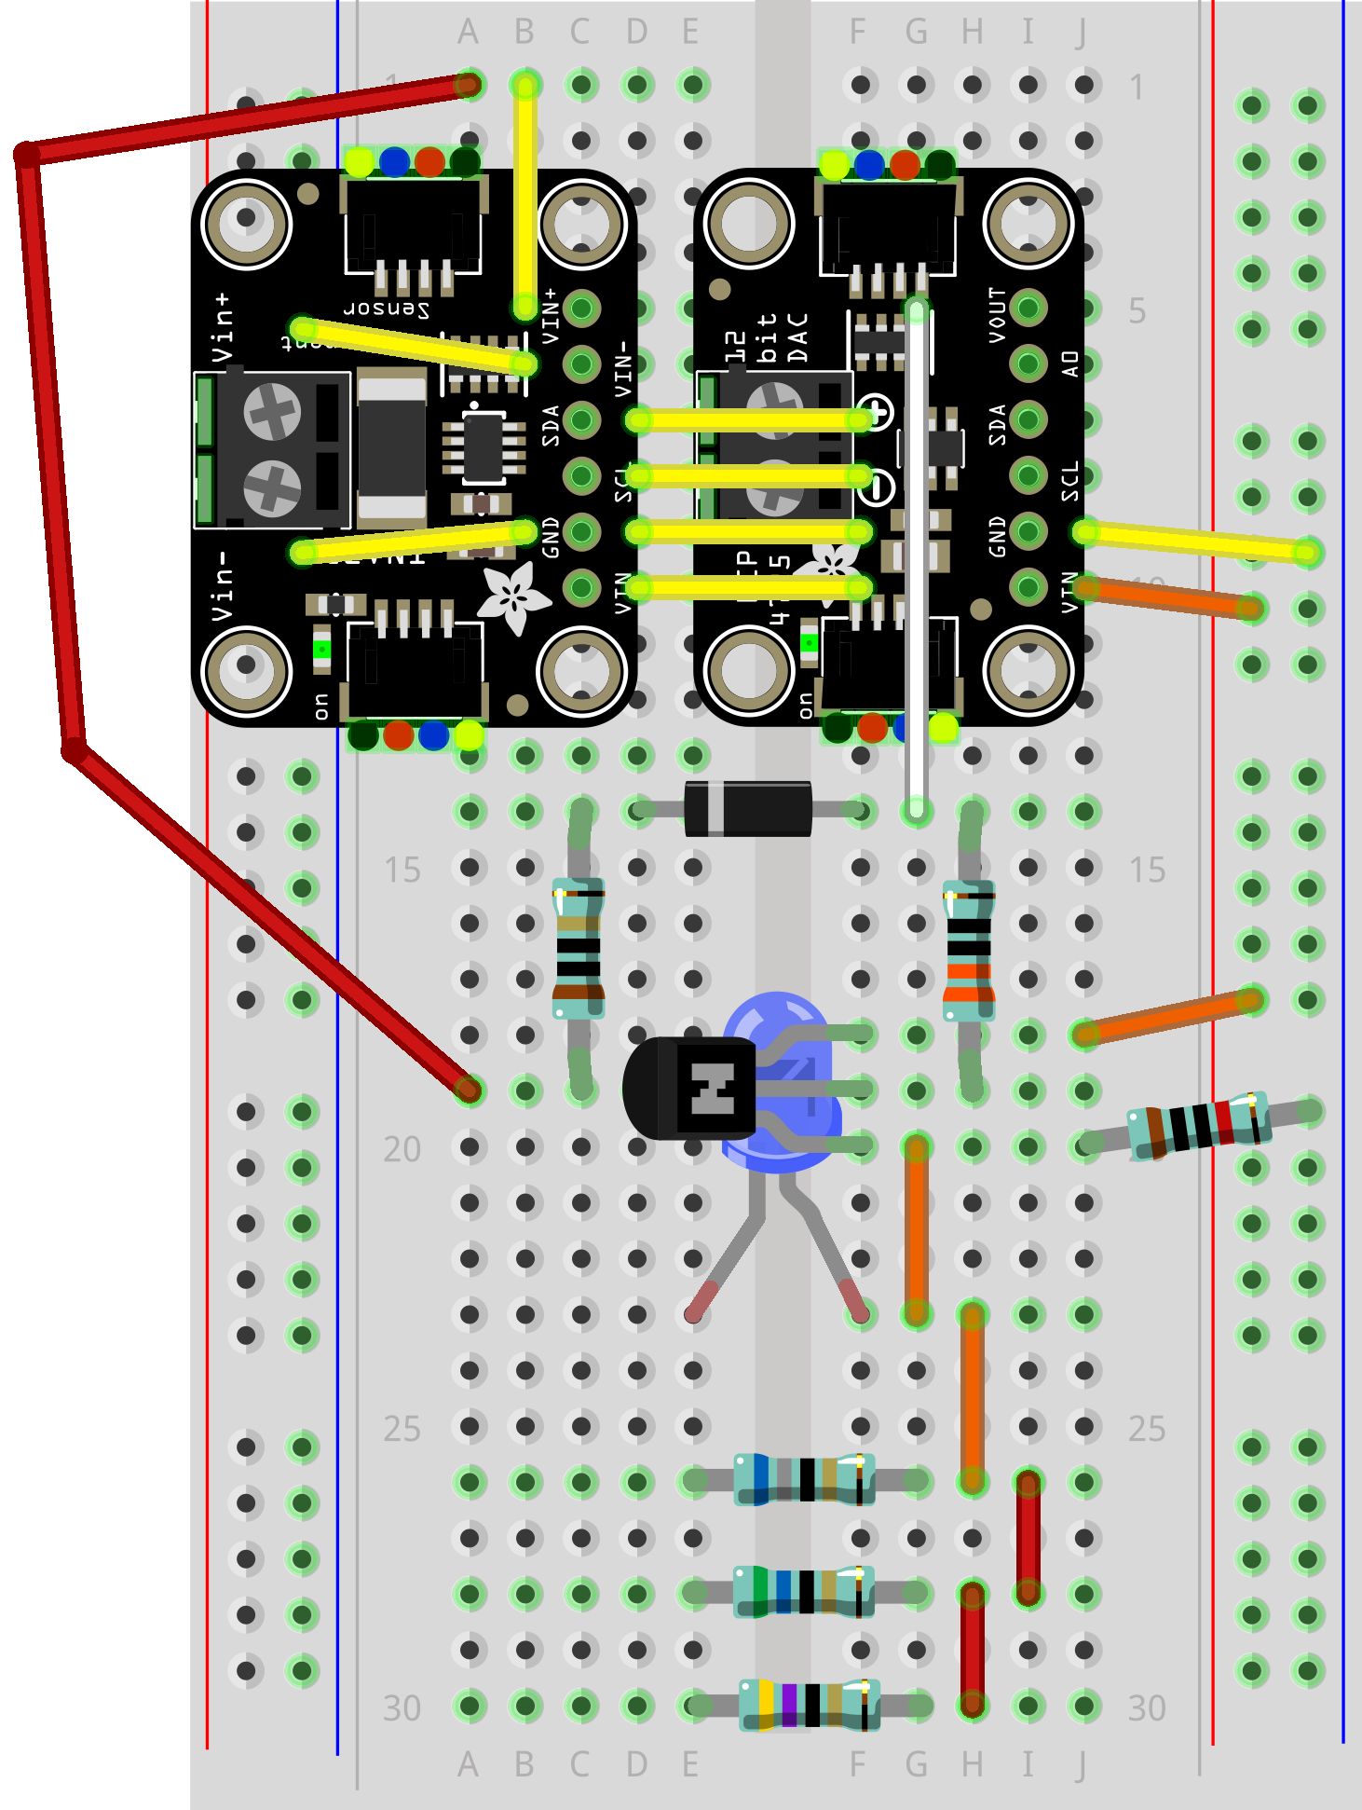
Wire Your Pico to Board 03
RED Jumper Wire
This 10K Ω resistor prevents pulling too much current out of the DAC

Slide 16
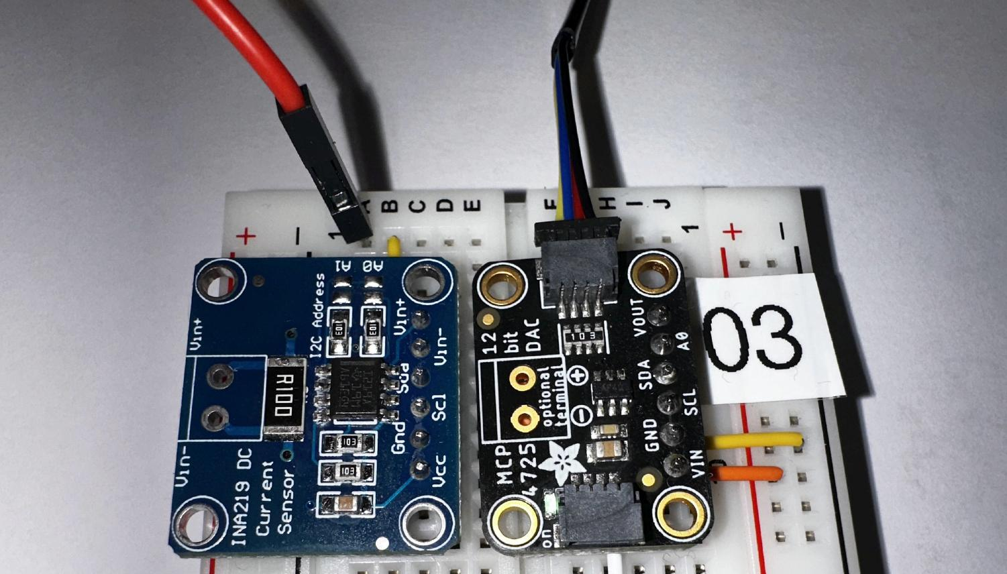
Wire Your Pico to Board 03
Qwiic Cable goes into the DAC

Slide 17
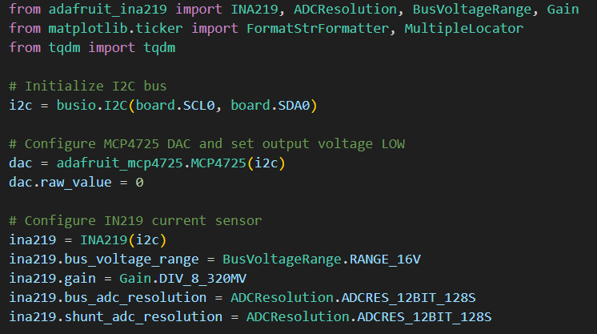
Open diode_ivcurve.py
①
②
③
④

Slide 18
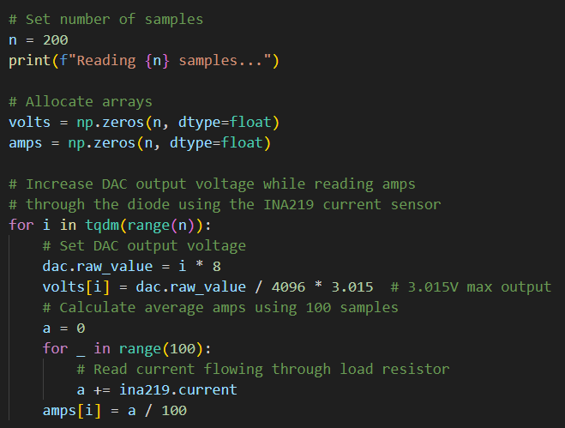

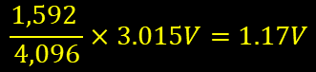
View diode_ivcurve.py
①
②
③
$$199×8=1,592$$
$$\frac{1,592 }{4,096}×3.015V=1.17V$$
④
⑤
⑥
⑦
⑧
⑨

Slide 19
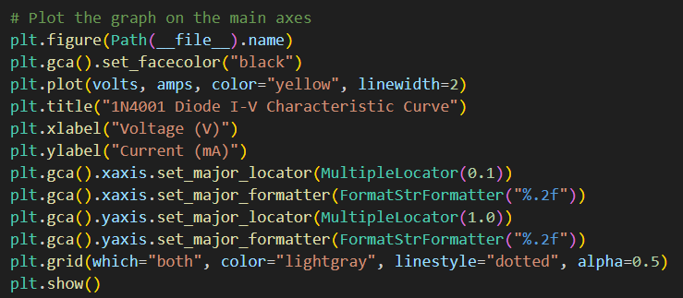
View diode_ivcurve.py
①
②
③
④
⑤

Slide 20
Connect the Pico to Your PC
If you incorrectly connect a jumper wire between the Pico and the breadboard, you can permanently damage your PC’s USB port!
Have your partner double-check your wiring before you plug in the USB cable back into your PC

Slide 21
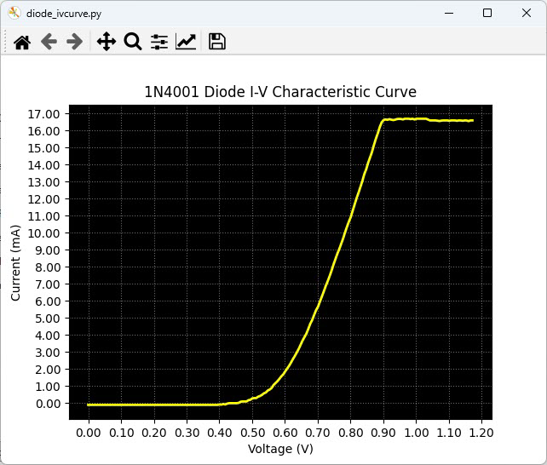
Run diode_ivcurve.py

Slide 22
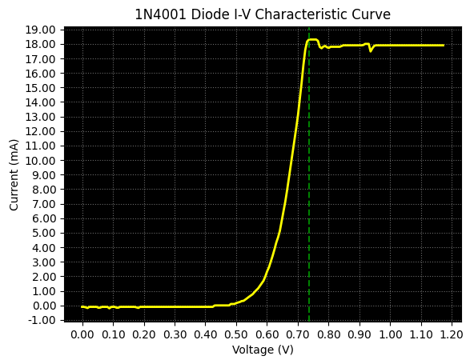
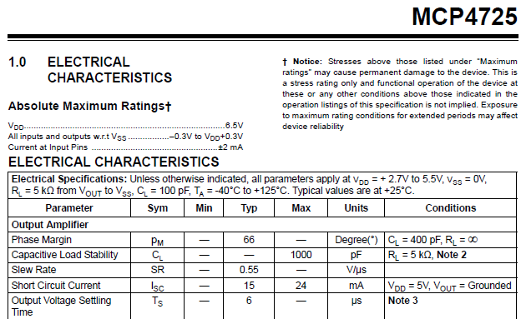
Check diode_ivcurve.py
Constant Slope
“Ohmic” Region
The MCP4725 can typically only source about 18 mA
"Knee" or cut-in voltage region

Slide 23
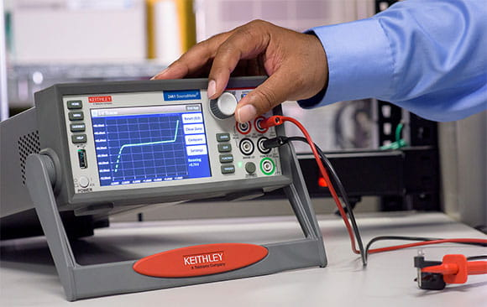
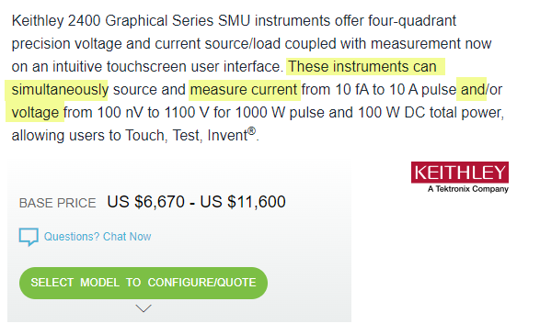
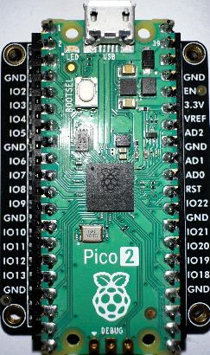
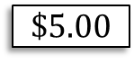
The Value of Knowing How to Code
$$\$5.00$$

Slide 24
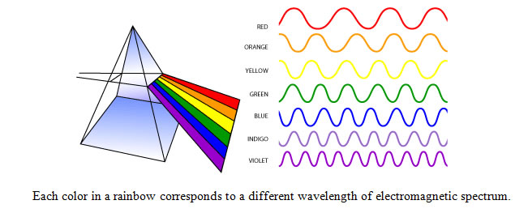
The Visible Light Spectrum

Slide 25
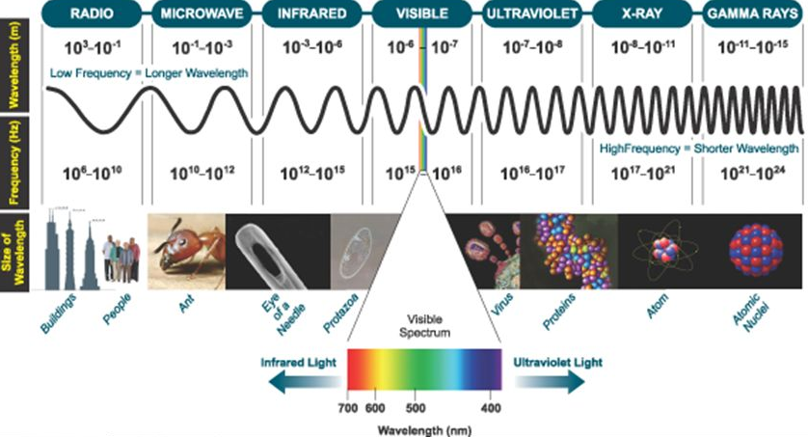
The Complete “Light” Spectrum

Slide 26
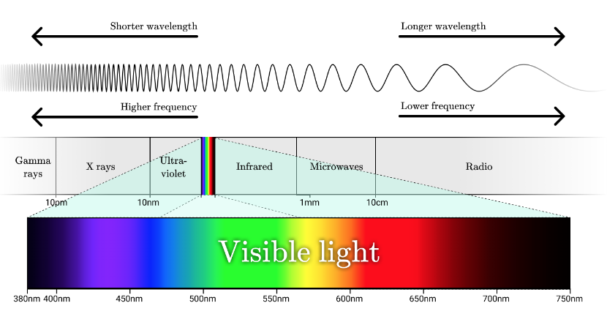
The Visible Light Spectrum

Slide 27
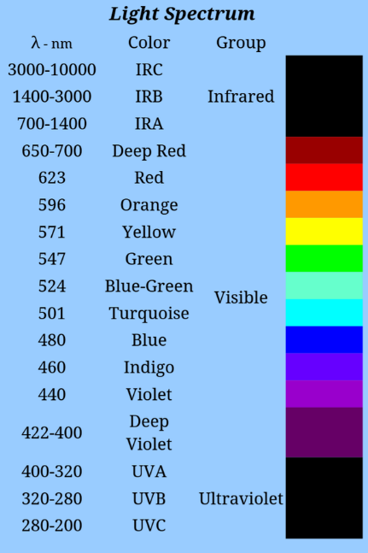
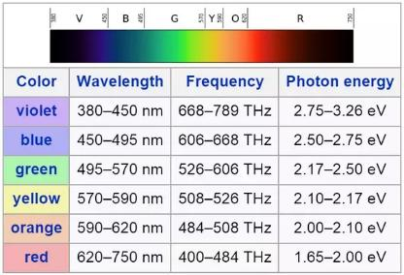
Light Spectrum
But how is light produced from energy?

Slide 28
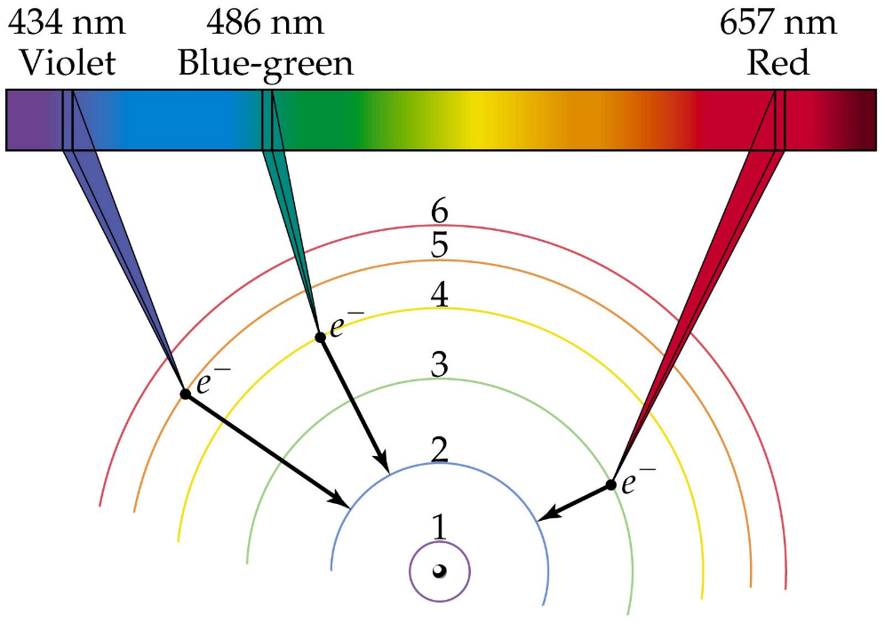
Electron Transitions Emit Photons
←Increasing Energy
The higher the initial orbit of the electron, the more energy it radiates when it transitions to a lower orbit

Slide 29
Band Gap Energy for a Red LED
LEDs that glow Red typically emit light with a wavelength between 620-750 nanometers (nm)
We can calculate the Band Gap Energy for a Red LED using Einstein’s Equation from his famous 1905 paper
$$E=\frac{hc}{λ}$$
$E=$ Energy in electron volts $(eV)$
$h=$ Planck’s constant $(4.1357 ×{10}^{−15} eV⋅s)$
$c=$ Speed of Light in a vacuum $(3 ×{10}^{8} m/s)$
$λ=$ Wavelength in meters $(m)$

Slide 30
Band Gap Energy for a Red LED
LEDs that glow Red typically emit light with a wavelength between 620-750 nanometers (nm)
Therefore, to make a Red LED have an easily visible glow, we need to provide 1.91 V
$$E=\frac{hc}{λ}=\frac{\left(4.1357×{10}^{−15}\right)\left(3 ×{10}^{8}\right)}{650×{10}^{−9}}=1.91 V$$

Slide 31
Lab Design
But now we want to drive a Blue LED by having the MCP4725 DAC provide sufficient voltage to the LED anode such that the Blue LED will turn on and shine brightly
A typical small 5mm Blue LED requires a minimum current of 20mA to emit enough photons to be visibly lit
Unfortunately, as we saw in the prior lab, our DAC can only source a maximum of about 18mA
Fortunately, we can configure a PN2222A NPN transistor as a Common Collector amplifier to help boost the LED current up to the maximum the I²C Bus can provide (via the Qwiic connector from the MCU), which is about 50mA

Slide 32
Lab Design
A Common Collector amplifier is often called an Emitter Follower (or Buffer) as it offers only unity gain (1x) in voltage, but can provide significant current gain
A CC amplifier has high input impedance, which minimizes loading effects on the preceding stage (i.e., the DAC)
In a CC configuration, we take the output from the Emitter pin (as opposed to the Collector pin in a Common Emitter amplifier, as we saw on Board # 02)
Unlike a CE amplifier, in which the output phase is inverted compared to the input, with a CC amplifier, the output is in phase with the input

Slide 33
Unplug the MCU before changing any wiring!
As we move between each “experiment” on a given breadboard or switch to an entirely new Board #, it is crucial that you FIRST UNPLUG the USB cord!
I recommend unplugging the cord at the PC end – leave the cord connected to the Micro USB port on the Pico
It is dangerous to change any wiring while the MCU is still drawing power from your laptop’s USB port. (NOTE: We will do this only during this Ohm’s Law lab on Board #3!)
If you incorrectly connect a jumper wire between the Pico and the breadboard while the Pico is drawing power from your PC, you can permanently damage your PC’s USB port
Have your partner double-check your wiring every step!

Slide 34
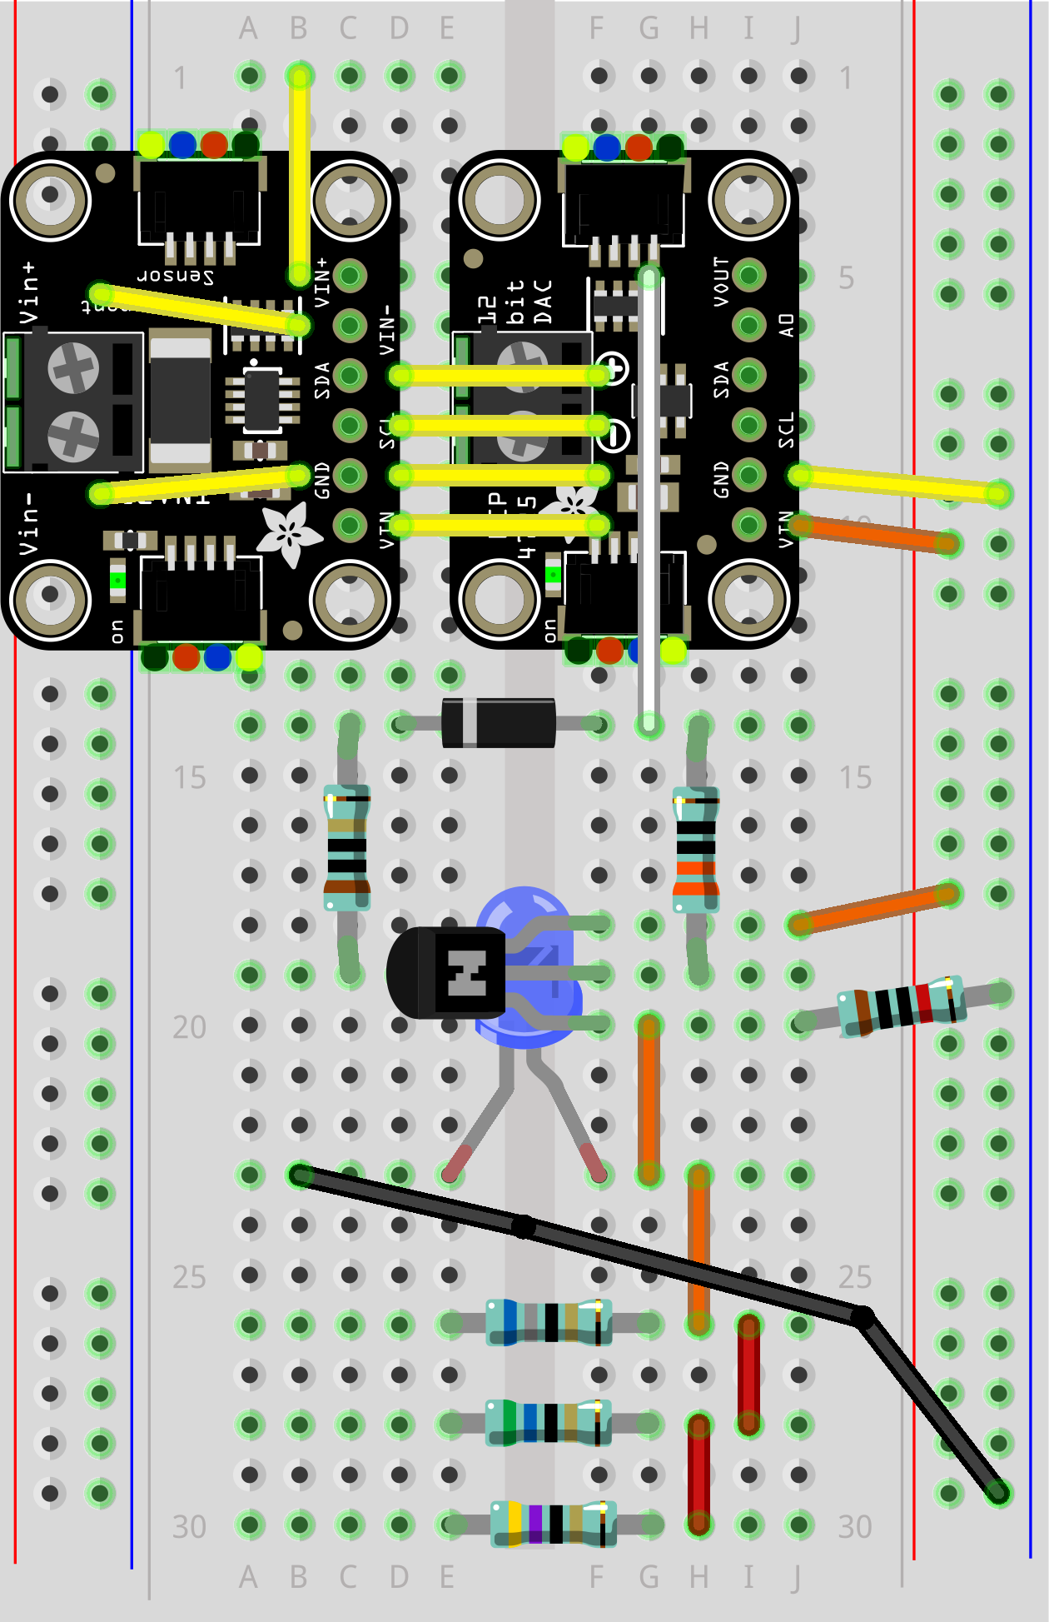
Wire Your Pico to Board 03
A 330 Ω resistor limits the current flowing into the BJT Base
In the Common Collector configuration, we take the BJT output from the Emitter pin
As a buffer,
the Collector pin
is tied to V_{CC}
As a buffer,
the Emitter pin is tied to GND through a resistor
(here a 10K Ω)
BLACK Jumper Wire

Slide 35
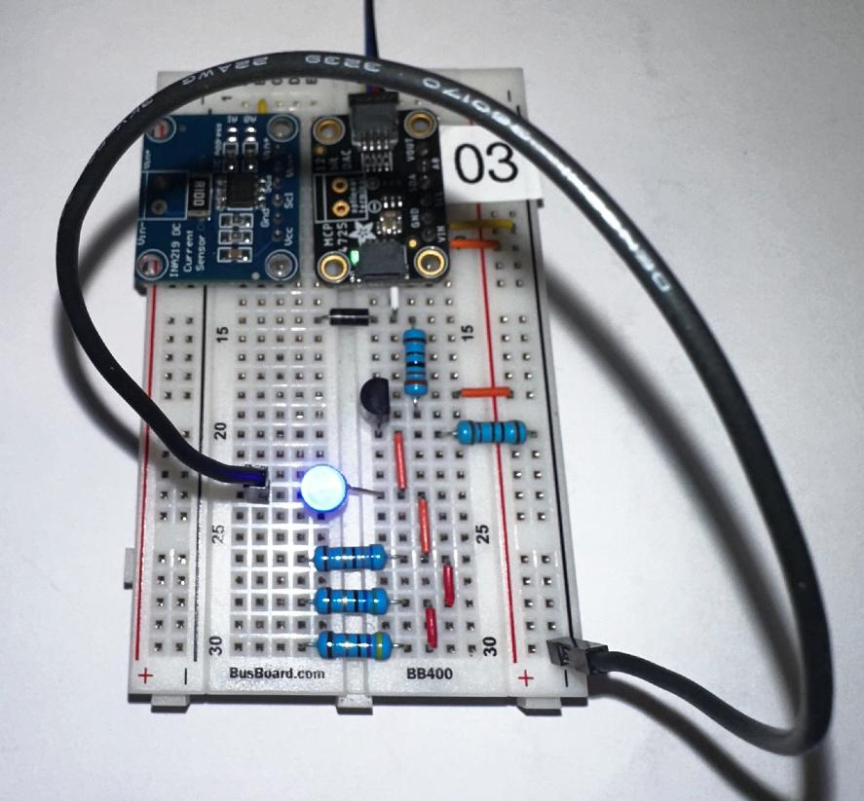
Wire Your Pico to Board 03
The goal is to shine the Blue LED brightly

Slide 36
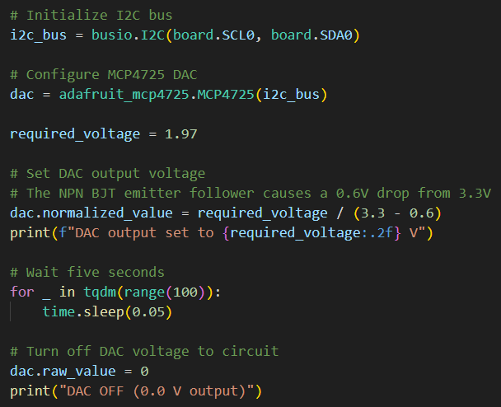
Open band_gap.py
①
②
③
④
⑤
⑥
⑦

Slide 37
Connect the Pico to Your PC
If you incorrectly connect a jumper wire between the Pico and the breadboard, you can permanently damage your PC’s USB port!
Have your partner double-check your wiring before you plug in the USB cable back into your PC

Slide 38
Run band_gap.py
What happened to the Blue LED?

Slide 39
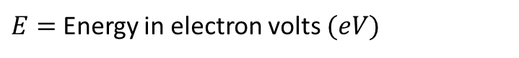
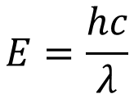



Band Gap Energy for a Blue LED
LEDs that glow Blue typically emit light with a wavelength between 450-495 nanometers (nm)
What voltage must we supply to light up a Blue LED?
$$E=\frac{hc}{λ}$$
$E=$ Energy in electron volts $(eV)$
$h=$ Planck’s constant $(4.1357 ×{10}^{−15} eV⋅s)$
$c=$ Speed of Light in a vacuum $(3 ×{10}^{8} m/s)$
$λ=$ Wavelength in meters $(m)$

Slide 40

Band Gap Energy for a Blue LED
LEDs that glow Blue typically emit light with a wavelength between 450-495 nanometers (nm)
Therefore, to make a Blue LED have an easily visible glow, we need to provide 2.64 V
$$E=\frac{hc}{λ}=\frac{\left(4.1357×{10}^{−15}\right)\left(3 ×{10}^{8}\right)}{470×{10}^{−9}}=2.64 V$$

Slide 41

Edit band_gap.py
①

Slide 42

Run band_gap.py
Albert Einstein 1905
(26 years old)
What happened to the Blue LED?

Slide 43






Voltage, Current, Resistance
Potential Energy
Amount
of Flow
V = Voltage
Volts (V)
I = Current
Amps (A)
R = Resistance
Ohms ($Ω$)
Alessandro Volta
(1745 – 1827)
André Ampère
(1775 – 1836)
Georg Ohm
(1789 – 1854)

Slide 44




Voltage, Current, Resistance
Current
Ohm's Law
Volts
Resistance
$$V=IR$$
A Circuit
Schematic
James Watt
(1736 – 1819)
Joules (Energy) per second

Slide 45

Walking in Ohm's Footsteps
Ohm's Law is a mathematical relationship between voltage, current, and resistance
$$v=iR→i=\frac{v}{R}→R=\frac{v}{i}$$
Ohm did not imply that if you divide the voltage output of a circuit by an infinitely small resistance, then that circuit will be able to produce an infinite amount of current
Most circuits are current limited – even batteries can only provide a certain maximum number of amp-hours
Resistance can vary by the temperature of the resistor
Resistance can be considered a ratio of voltage to current – think of $v/i$ as the slope of a line
Electrical engineers use $j$ for $\sqrt{−1}$

Slide 46




Method of Least Squares
Carl Friedrich Gauss
(1777-1855)

Slide 47
Walking in Ohm's Footsteps
We want to sample (measure) the current flowing through an unknown resistor as we slowly increase voltage
Using linear regression (method of least squares), we can calculate the line of best fit which passes through the observed data values (volts vs. current)
The slope of that line is the ratio $v/i$ which will tell us the resistance in Ohms of the unknown resistor under test

Slide 48
Unplug the MCU before changing any wiring!
As we move between each “experiment” on a given breadboard or switch to an entirely new Board #, it is crucial that you FIRST UNPLUG the USB cord!
I recommend unplugging the cord at the PC end – leave the cord connected to the Micro USB port on the Pico
It is dangerous to change any wiring while the MCU is still drawing power from your laptop’s USB port. (NOTE: We will do this only during this Ohm’s Law lab on Board #3!)
If you incorrectly connect a jumper wire between the Pico and the breadboard while the Pico is drawing power from your PC, you can permanently damage your PC’s USB port
Have your partner double-check your wiring every step!

Slide 49

Wire Your Pico to Board 03
RED Jumper Wire
This Common Collector amplifier (Buffer) will provide enough current so that even after passing through the unknown resistor, the INA219 will get a reasonably accurate measurement
The Emitter pin output will be 0.66V lower than the DAC output pin, but it can source a much higher current
Unknown Resistor 1

Slide 50

Wire Your Pico to Board 03

Slide 51

Wire Your Pico to Board 03
The red jumper goes to 1st resistor

Slide 52

Wire Your Pico to Board 03
This yellow wire routes to the input pin (Vin+) of the Current Sensor

Slide 53

Open ohms_read.py
①
②
③
④
⑤
⑥
⑦

Slide 54

View ohms_read.py
①
②
③
④
⑤
⑥
⑦
⑧
⑨

Slide 55

View ohms_read.py
①
②
③
④
⑤

Slide 56
Connect the Pico to Your PC
If you incorrectly connect a jumper wire between the Pico and the breadboard, you can permanently damage your PC’s USB port!
Have your partner double-check your wiring before you plug in the USB cable back into your PC

Slide 57

Run ohms_read.py
①
②

Slide 58

Wire Your Pico to Board 03
RED Jumper Wire
Unknown Resistor 2

Slide 59

Wire Your Pico to Board 03
The red jumper goes to 2nd resistor

Slide 60

Run ohms_read.py
①
②

Slide 61

Wire Your Pico to Board 03
RED Jumper Wire
Unknown Resistor 3

Slide 62

Wire Your Pico to Board 03
The red jumper goes to 3rd resistor

Slide 63

Run ohms_read.py
①
②

Slide 64

Open resistor3.csv
Volts, Amps
A comma-separated value (CSV) data file
①

Slide 65


Open ohms_plot.py
①
②
③
④
⑤
⑦
⑥

Slide 66

View ohms_plot.py
①
②
③
④
⑤

Slide 67

View ohms_plot.py
①
②
③
④
⑤
⑥

Slide 68

Run ohms_plot.py
Why does the strongest resistor have the lowest slope?

Slide 69


Check ohms_plot.py
Why are our estimates wrong?
68 Ω
56 Ω
47 Ω

Slide 70



Defensive & Defensible Sampling
https://www.amazon.com/gp/product/B07QDXV69F
$$47+ \left(47\right)\left(1\%\right)=47.47Ω$$
Resistor variance is not the primary suspect
By taking a sample range, finding the line of best fit, and then interpolating, we can reduce measurement errors
Remain skeptical of your instruments!

Slide 71
The Nature of Semiconductors
Diodes are often used as one-way "valves" to eliminate unwanted voltage amplitudes or phases in alternating current (AC) circuits
Diodes are also used as switches, blocking current flow until the supplied voltage rises above its cutoff limit
When a diode is sufficiently forward-biased, its depletion region shrinks to the point where many electrons can cross the P-N junction barrier, and current flow is established
A diode that is reversed biased blocks the flow of current
The diode i-v curve for a 1N4001 rectifier shows the classic knee shape as it starts to pass current very easily

Slide 72
The Nature of Semiconductors
The word “transistor” is the combination of transconductance (controls current) and varistor (a resistor that changes its strength based upon applied voltage)
In a Common Emitter circuit, the BJT output is taken from the Collector pin. In a Common Collector circuit, the BJT output is taken from the Emitter pin
Most semiconductor components are generally non-ohmic except in a specific (active/linear) voltage region
Every transistor has cutoff, active, and saturation regions for a given circuit – always consult the vendor's product datasheet for details

